Slide 1
Pathology 438 Toxicology Spring 2015 term
Mitch Halloran, Ph.D.
Prepared especially for Life Chiropractic College West

Slide 2
Course Overview
Course Description
Toxicology studies the body’s response to drugs, foods, and toxic substances. Fundamentals of pharmacology and mechanisms of action are examined for acute and chronic exposure derived from environmental, dietary, occupational and pharmaceutical sources. Emphasis is placed on information literacy to support problem-based and evidence-based learning.

Slide 3
Course Overview
Prerequisites
CHEM 223, PATH 227
Weekly Lecture Days & Times
Monday afternoons
1:00 to 2:50
according to LCCW term calendar, holidays excepted

Slide 4
Required Knowledge
Much of the content you should know are on these slides: this is from the instructor
Other knowledge is what you will get in preparing your presentations: this knowledge is from your research and that of the other students
Slides (as PDF format, sometimes as PPTX format) will be made available to you
You should attend lectures as required since the talk will elaborate many things. Note takers can write slide number and record lecturer's comments

Slide 5
The Slides: What You Should Learn
Do not look at the number of slides and panic!
Many of these slides repeat (as a summary) information in previous slides
These slides present a relatively encyclopedic knowledge of the subject, but you are not expected to have that knowledge for assessments (exams)
Some slides represent in a repetitive way the textual bullet points as interesting images and interesting illustrations
A picture worth a thousand words
Where you see magenta-colored text or a yellow slide background, that is my clue to you that this item is more (encyclopedic) detail than you are expected to memorize
it would be nice for you to learn, and you will probably encounter
its like in your presentation project, but you are not required to know it

Slide 6
Course Overview: Literature
Required Text
Harvey, Clark, Finkel, Rey, Whalen (2012) Pharmacology, 5th Ed (Lippincott, Williams & Wilkins)
Recommended Texts
Hodgson (2010) A Textbook of Modern Toxicology, 4th Ed
Smart & Hodgson, eds (2008) Molecular and Biochemical Toxicology, 4th Ed
Frank & Ottoboni (2011) The Dose Makes The Poison: A Plain-Language Guide to Toxicology, 3rd Ed
Ottoboni (1997) The Dose Makes The Poison: A Plain-Language Guide to Toxicology, 2nd Ed.
Gaby, Batz, Chester, Constantine (eds) (2006) A-Z Guide to Drug-Herb-Vitamin Interactions, 2nd Ed

Slide 7
Course Overview: Literature
Recommended Texts
Gilbert (2004) A Small Dose of Toxicology: The Health Effects of Common Chemicals
Gibson (2000) Multiple Chemical Sensitivities: A Survival Guide
Cupp & Karch (eds) (2000) Toxicology and Clinical Pharmacology of Herbal Products
Lawson (2000) Staying Well in a Toxic World
Reference Text
Klaassen (ed) (2008) Casarett & Doull's Toxicology, 7th Ed
All books on reserve in library

Slide 8
Instruction Details
Grading/Evaluation
Submission of Presentation & Clean Research Question (25% -- 100 pts)
Oral presentation in digital form (electronic copy)
Must have clean research question
Submitted NO LATER than ONE WEEK BEFORE scheduled date of presentation
Clean, concise research question for your presentation is submitted emphasizing central, "take home" theme of your work
Oral Presentation (25% -- 100 pts)
Weeks 7 and 8 of term
8-12 min presentations, including the Q & A

Slide 9
Instruction Details
Grading/Evaluation Continued
Midterm Examination (25% -- 100 pts)
TAKE-HOME midterm due at start of class in Week 5
will be posted on MOODLE
covers pharmacokinetics, pharmacodynamics, detoxification pathways, biochemistry, textbook topics, material in lectures
ALL WORK is individual (no group interaction!)
Final Examination (25% -- 100 pts)
one final in Week 11
covers
lecture content
student-generated clean research questions
student oral presentation content

Slide 10
Instruction Details
Grades
Instructor communication / interaction
email: shalloran@lifewest.edu
office hours: Wednesdays, 12-1 pm Room 147 (adjunct room)
phone: (916) 410-7133
MOODLE: digital based content (pretty much everything)
Dropbox student representative?
90-100% | A
80-90% | B
70-80% | C
< 70% | F

Slide 11
Oral Presentations
Presented in weeks 7 and 8
TWO students per group
Select topic related to toxicology
Possible topics: personal care products, GMOs, processed foods, water & air quality, environmental pollution, drugs, poisons
Presentations are 8-12 min
ALL CONTENT should include references to peer-reviewed literature
if claims of a website are presented, then back up the claims to accepted sources (peer-reviewed science)

Slide 12
Oral Presentation Content
With your toxins, cover the following questions:
What is your clean research question that motivates your study of this selected topic?
What is your toxin? What is its chemical structure and what natural compounds does it mimic?
Where is it found and how are individuals exposed to the toxin?
What is its mechanism of action and target organ(s) of injury? What is the dose-response for toxic action and injury?

Slide 13
Oral Presentation Content
With your toxins, cover the following questions:
How is the toxin metabolized and eliminated from the body and what is its biological half-life?
What is the risk of exposure and how prevalent is the exposure to the public?
Are there any safer alternatives?

Slide 14
Clean Research Question
Group should develop clean, concise research question
Email the question and the presentation to shalloran@lifewest.edu not less than 1 week in advance of the scheduled date of presentation to class

Slide 15
Examples
What are the effects of "fragrance" on the human body?
How does Helicobacter Pylori (H. Pylori) contribute to the development of gastric carcinoma?
Is tattoo ink safe and if not how toxic is it to the body?
What common building material poses significant health risks? Pressure Treated Wood (Chromated Copper Arsenic)
Does an average everyday exposure of cyanide cause enough of a toxicity level to create adverse effects?

Slide 16
Oral Presentation Suggested Format
Your approach to the topic may be:
Introduction to topic which includes short historical background
Review of literature with selected but important reports highly descriptive of thesis
Recent advances in the field
Clinical correlations and significance of a basic science concept

Slide 17
Principles of Pharmacology & Toxicology
Week 1

Slide 18
Toxicology Defined
Study of adverse effects of chemical or physical agents on living organisms
Casarett & Doull's Toxicology
The study of the adverse effects of chemical, physical, or biological agents on people, animals, and the environment
Society of Toxicology (web page)
The study of poisonous chemicals, drugs, etc., and how a person or other living thing reacts to them
Merriam-Webster online

Slide 19
Terminology
Toxic Agents
any substance producing toxicity
Toxins
toxic agent produced by biological systems
plant, animal, bacteria, fungi
Toxicants
toxic agents produced by or by-product of human activity
Exposure
physical contact or dosing with a toxic agent

Slide 20
Toxicologic
Chemical Allergy
immunologically mediated reaction to a chemical
may involve sensitization (pre-exposure)
hypersensitivity reaction observed thereafter
chemicals not sufficiently immunogenic, so combines with protein as hapten to be immunogenic
Chemical Idiosyncracy
abnormal reaction to chemical
genetically based
long duration of succinylcholine metabolism because of slow-metabolizing pseudocholinesterase phenotype
NADH-cytochrome b5 reductase deficiency: susceptibility to nitrites, leading to methemoglobin formation, low oxygen carrying capability

Slide 21
Toxicologic
Immediate vs Delayed Toxicity
Some toxic effects may not be seen for years, such as carcinogens causing disease decades later
Vaginal cancers in young adult females whose mothers used diethylstibestrol (DES) with in utero exposure (20-30 y later)
Organophosphorus insecticides (e.g. triorthocresylphoshate [TOCP]) causing degeneration of long axons in PNS & CNS over several days

Slide 22
Overlap with Pharmacology
Principles of toxicology overlaps a great deal with the fundamentals of pharmacology
Drugs both natural and synthetic can be given at one dose to achieve a desired or intended therapeutic effect, but at a higher dose can produce a toxic effect
Thus, concepts in pharmacology are presented in concert with instruction in toxicology

Slide 23
Good Things & Bad Things
A Philosophical Consideration
Bad Things Always Bad Things (Or Are They?)
Snake venom always thought bad
But many venoms or their refined molecular products used for medical therapy
Thus: Good Things Sometimes Bad Things
A lesson?
Be prepared to evaluate the "incontrovertible facts" from time to time

Slide 24
Toxicant Chemistry
Lipophilic / Hydrophobic / Fat-Soluble
alkyl (methylene: –CH₂–)
Hydrophilic / Water-Soluble
Polar Nonionic: hydroxyl –OH groups
Ionic (pH-dependent and –independent)
Cationic (+ charged): amine –NH₂ groups
Anionic (– charged): carboxyl –COOH groups

Slide 25
Toxicant Permeability
Fully lipophilic toxicants can easily cross cell membrane phospholipid bilayers
Toxicants with any ionized (positively or negatively electrically charged) functional groups cannot freely cross the lipid bilayer
This includes zwitterionic toxicants that may have a net charge of zero on the molecule
An absence of charged groups does not guarantee membrane permeability, since functional groups may have significant hydrophilic polar groups

Slide 26
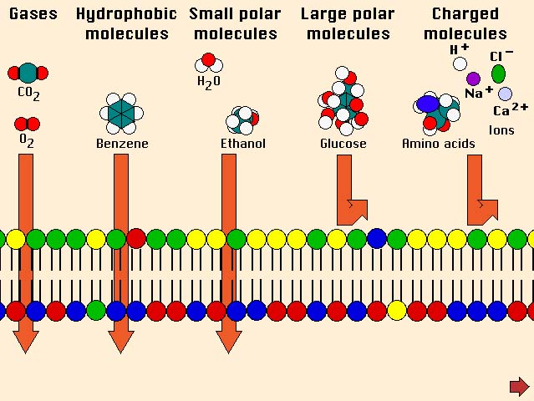
Chemistry of Membrane Permeability
Molecules having no net polarity ("dipole"), especially hydrophobic or lipophilic, cross the lipophilic lipid bilayer of cell membranes without difficulty
Molecules having a net polarity or having many polar groups or having electric charges (ions) do not cross the membrane
Impermeable molecules must have special channel or transport proteins in membrane to open gate for them to cross

Slide 27
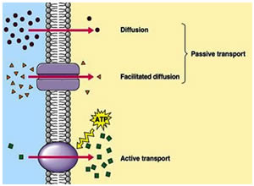
Getting Across A Membrane
Thermodynamic laws explain that molecules will diffuse within a space (volume) to distribute themselves evenly within that space: it's same for the volume of the body
Cell membranes represent a barrier to this diffusion for most, not all molecules
For those that can cross membranes, the simple diffusion process works
For others, proteins move with their concentration gradient through channels in membrane proteins
http://pharmafactz.com/wp/wp-content/uploads/2014/12/active-transport.jpg

Slide 28
Getting Across A Membrane
Active transport uses the cell's energy (ATP) to move molecules against their concentration gradient
The figure shows an ATP-dependent transport membrane protein moving molecules into a cell, but there are many ATP-dependent transporters that use energy to move molecules out of cells (e.g., the drug efflux transporters mentioned in this course)
http://pharmafactz.com/wp/wp-content/uploads/2014/12/active-transport.jpg

Slide 29
Permeability & pH-Dependence
Toxicant
Class
red boxed toxicants not guaranteed permeability, but have stronger potential
zwitterions
HOOC
N⁺H₃
–OOC
N⁺H₃
–OOC
NH₂
acidic
COOH
COO–
COO–
basic
N⁺H₃
N⁺H₃
NH₂
low pH
neutral pH
high pH

Slide 30
Dose-Response
Dose: administer substance (drug, poison) in specific quantity
Response: observe a variety of effects, whether intended/expected or unintended/unexpected
The "therapeutic" effect: a desired effect from a drug (not an effect for toxicology)
The "side" effect: the willingness to tolerate unpleasant, uncomfortable, and sometimes painful effects in order to obtain the therapeutic effect
The "toxic" effect: the intolerable circumstance where health or life is endangered; generally an acute effect; chronic effects less perceptible

Slide 31
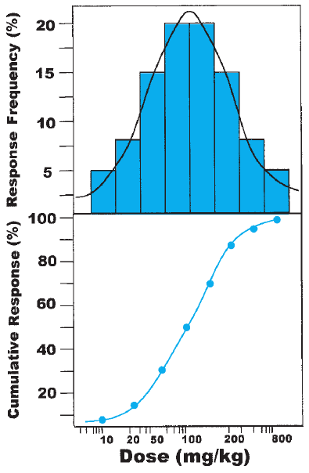
Responses in Populations
The dose at which individuals in a population show a response (effect) to a drug or toxicant is normally distributed generally
top panel in figure
The plot of the cumulative percentage showing the response to the dose has value in determining the dosage for drug
This is the Dose-Response curve/plot
bottom panel in figure

Slide 32
The Dose-Response Curve
Dose-Response relationships are plotted as the cumulative percentage of a population showing an effect as a particular dose
They are used for setting the appropriate dose of a drug
The ED₅₀ parameter refers to the "effective dose" for 50% of the population
That is, the ED₅₀ is the dose at which the desired effect is produced in 50% of the population

Slide 33
Toxic Doses / Lethal Doses
The Dose-Response curves apply for all manner of responses:
toxic response
toxic response 1 (TR1): suppose loss of vision
toxic response 2 (TR2): suppose hemiplegia
the dose producing toxicity in 50% of the population: TD₅₀
lethal response
the ultimate toxic response
the dose producing death in 50% of the individual in the population is the LD₅₀

Slide 34
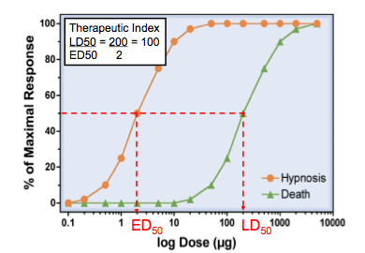
Therapeutic Index
In pharmacology, this value is a measure of how safe a (therapeutic) drug is with respect to obtaining the intended effect and risking seeing a toxic effect, especially the lethal effect
This is the ratio TD₅₀ / ED₅₀
Agonist | TI
THC (cannabis) | 1000
diazepam | 100
morphine | 70
digoxin | 2

Slide 35
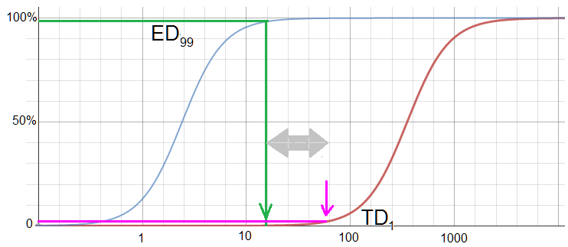
Margin of Safety: TD₁ ÷ ED₉₉
Another parameter of the dose-response curve is the margin of safety, the ratio of TD₁ ÷ ED₉₉
If the TD₁ is really the LD₁, then this would be of more value than a therapeutic index, in the even that the ED curve near 100% could even overlap the LD curve at close to 0%

Slide 36
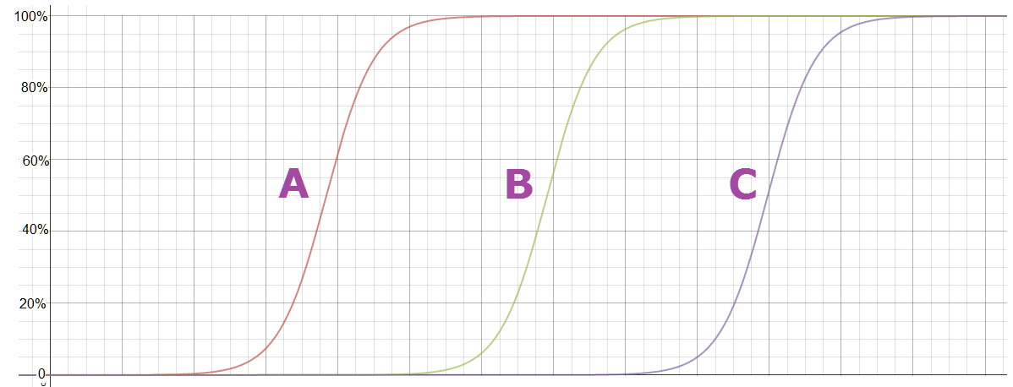
Potency
Potency reflects the amount of drug/toxicant necessary to produce the effect
It is a comparative tool for drugs/toxicants producing the same effect
Suppose A, B, C are toxicants causing tumors in test animals: as the curve shows, A produces the effect at lower doses than B or C, and so it is more potent than either B or C

Slide 37
Toxicokinetics / Pharmacokinetics
The study of how a drug enters the body, is changed by the body, and is eliminated by the body
Four processes describe toxico/pharmacokinetics:
Absorption
The process where a toxicant passes barriers (GI tract, skin, lung aveoli) to get into the systemic circulation
Distribution
The process where the toxicant increases its concentration in vascular, interstitial and intracellular volume

Slide 38
Toxicokinetics / Pharmacokinetics (cont)
Metabolism (Biotransformation)
The process where the cell reduces the level/concentration of toxicant (de-toxifies) by chemically modifying it
Elimination
The process in which the body attempts to excrete the toxicant or a modified form of it (its detoxified products)

Slide 39
Absorption
This is about getting a toxicant/drug past the barriers to the systemic circulation
Ingestion / Oral
Most any toxicant in a pill/tablet/liquid
Inhalation
Gaseous/vapor toxicants
Dermal
lipophilic toxicants particularly
Rectal
suppositories
does not include intravenous (i.v.) administration, since that is a direct route past the barriers

Slide 40
Chemistry of Absorption
The unionized (electrically uncharged) toxicant more readily passes a cell membrane barrier than an ionized toxicant
Absorption of pH-dependent toxicants affected by pH
[note: this information is a repeat of previous slides]

Slide 41
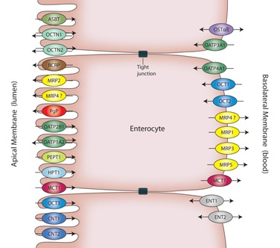
GI Tract
The intestines represent an initial barrier to absorption
Intestinal epithelial cells (enterocytes) form "tight junctions" as a barrier to simple diffusion of toxicants into blood
Additionally they have membrane proteins actively transporting xenobiotics back into intestinal lumen left side of cell in figure
while you don't need to memorize names of the efflux or exchange transporter proteins in the figure, you will likely encounter their mention
in the research you do for your presentations
http://www.solvobiotech.com/images/uploads/Enterocytes1.jpg

Slide 42
MDR Efflux Transporters
Certain membrane proteins (P-glycoprotein) use ATP to drive out cytotoxic xenobiotics, some of which are cancer drugs
These transporters pump out multiple drugs (multi-drug resistance [MDR]) with broad specificity and are present in a large variety of cell types
High expression of these proteins is likely in cells whose organs function as the first guard in exposure to toxicants
intestinal epithelium
liver hepatocytes

Slide 43
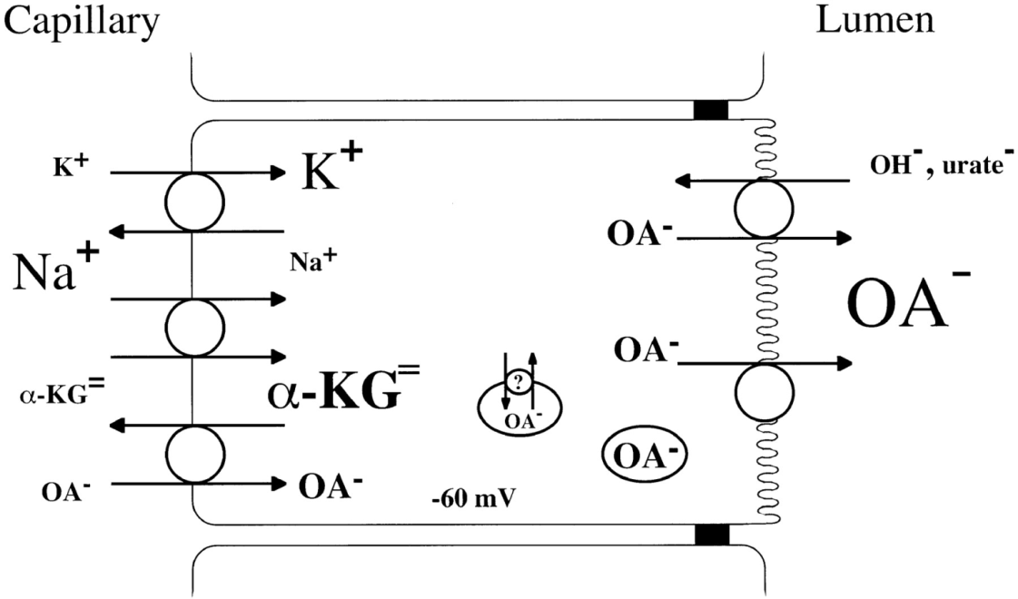
Coupled Ionic Transporters
This type of membrane protein transporters are also involved in the efflux of toxicants to prevent absorption into systemic circulation
Negatively charged toxicants (organic anions) are transported to the lumenal (excretory) side of epithelial cells in kidney and intestine
http://ajprenal.physiology.org/content/281/2/F197

Slide 44
Distribution
Distribution is the process of a drug/toxicant circulating the vascular volume and reaching the tissues, intracellular and interstitium
Factors affecting distribution include
blood flow: flow to organs (liver, kidney, brain) is greater than to other parts of body
capillary permeability
binding affinity of drugs/toxicants to plasma or tissue proteins

Slide 45
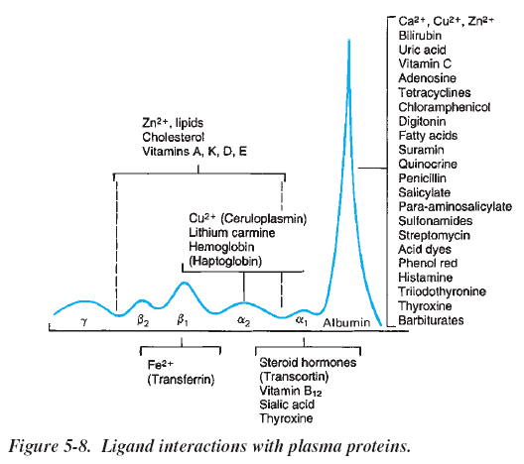
Plasma Protein Binding
Proteins in plasma will bind to many drugs, affecting and limiting their distribution outside vascular volume
Ligand-binding preferences
α & β lipoproteins
many lipophilic substances
α₁-acid glycoprotein
basic substances
metal-binding proteins
drugs/toxicants with metal cations

Slide 46
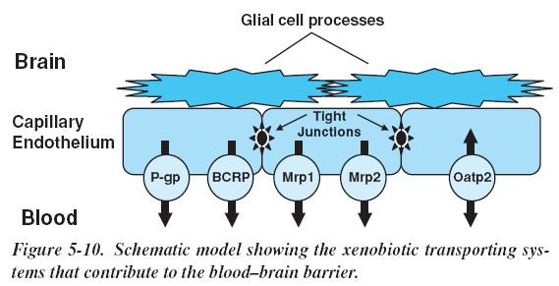
Blood-Brain Barrier
Distribution to CNS tissue & fluid space limited by blood-brain barrier
Endothelial cells in brain capillaries forming tight junctions to inhibit polar substances entering CNS
Xenobiotic efflux transporters in cells actively keep lipophilic substance out
Pgp + BCRP (cations+neutral) Mrp2 + Mrp4 (anions + neutral)
Glial cells (astrocytes + microglia) extend processes on endothelium to act as (reinforce) barrier

Slide 47
Blood-CSF Barrier
Epithelial cells of choroid plexus on other side of capillary epithelium form part of barrier. Cells have xenobiotic efflux transporters (as do endothelial cells)
Luminal P-gp and basolateral Mrp1
Oatp3, Oat3, Oct, and Pept2 also involved
("Oat"=organic anion transporter, "Oct"=org cation transporter)
The low protein content of CSF also prevents toxicity of xenobiotics that are protein binders

Slide 48
Facts about CNS Barriers
BBB not as well developed in newborns compared to adults so xenobiotics/drugs might enter brain
Some areas of the brain more accessible: cortex, hypothalamus lateral nuclei, neurohypophysis
bilirubin and morphine more toxic
due to increased blood supply to the these parts or is barrier more permeable?

Slide 49
Crossing The Placenta
Humans have a hemochorial placenta: the fetal placental tissues are cellular but the maternal cellularity is gone
Most nutrients move from maternal blood to fetal circulation by active transport

Slide 50

Volume of Distribution (V_{d})
Distribution is the process of a drug/toxicant leaving the circulation and reaching the tissues (intracellular and interstitium)
Factors affecting distribution include
blood flow: flow to organs (liver, kidney, brain) is greater than to other parts of body
capillary permeability
binding affinity of drugs/toxicants to plasma or tissue proteins
$$V_{d}=\frac{Dose}{C_{0}}$$
where C₀ is the plasma concentration at "time zero"
If possible, administer dose intravenously, then sample blood several times quickly after admininistration to approximate C₀

Slide 51
Bioavailability
Bioavailability is the fraction of drug/toxicant reaching systemic circulation compared to dose given
F = computed amount in circulation / dose
If 80 mg of a 100 mg dose reach circulation, then F = 0.80
This is important for determining doses of drugs/toxicants that enter circulation by non-intravenous routes
It is assumed that a drug/toxicant given intravenously has F = 1.0
Bioequivalence: If two drugs/toxicants show similar bioavailability and pharmacokinetics, they are bioequivalent

Slide 52
Bioavailability Factors
If toxicant/drug injected intravenously, F = 1.0 (bioavailability = 100%)
Oral administration of drug imposes factors:
First-pass hepatic metabolism
All drugs & toxicants absorbed in gut enter the portal vein to the liver, so are exposed to liver enzymes expressly designed to filter out and detoxify xenobiotics
Drug solubility
molecules should not be very lipophilic (insoluble in aqueous compartments) nor very hydrophilic (cannot easily cross membrane barriers
Best are those that are weak acids and bases

Slide 53
Bioavailability Factors (continued)
Chemical stability
For pharmacologically significant drugs, the molecular nature cannot be altered if it is to remain effective
Drug formulation characteristics
size of particles/grain: smaller size generally improves absorpition
salt vs free acid/free base form: site of absorption (stomach vs intestine)
enteric coating: site of absorption
binders, dispersing agents: affect dissolution

Slide 54
Detoxification
All cells of the body have the ability to chemically modify the molecules, including toxicants, that enter them
Most modifications are enzymatic, but non-enzymatic reactions can occur
Cells that form a lining that is a barrier between where toxicants can pass to a compartment will have mechanisms to detoxify or thwart passage
capillary endothelium, GI tract epithelium
The liver is the gate to the systemic circulation of substances that manage to get past the epithelial cells of the GI tract. It is a major organ of detoxification

Slide 55
Biotransformation
The response of the body (cells) to alter the toxicity of xenobiotics
Used for useful drugs and toxicants alike
Occurs in two phases (Phase I and Phase II)
Biotransformation involves biochemical reactions to chemically alter toxicants so that they become excretable
They also provide the possible additional benefits of detoxifying the toxicant and preventing its ability to easily cross membranes of cells and thus distribute itself throughout the body
All biotransformations are mediated by enzymes with but few exceptions where reactions are spontaneous

Slide 56
Phase I Biotransformation
Phase I involves chemical reactions that can radically alter the molecular structure of the toxicant
The intention is to add functional groups that "put a handle" on the molecule so it can excreted
The transformation also make the molecule polar or ionized, preventing the molecule from easily crossing cell membranes
Additionally the toxic nature can be neutralized
However in some cases, the resulting metabolite might be even more toxic

Slide 57
Phase I Reactions
Fall into three basic classes
Oxidation
Many of these reactions are catalyzed by the cytochrome P450 enzymes
Reduction
Many oxidoreductases and mono-oxygenases that depend on the co-enzymes NAD, NADP, FAD, and FMN are involved here
Hydrolysis
Enzymes that perform these reactions include carboxylesterases, peptidases, phosphatases, and other hydrolases

Slide 58
Phase II Biotransformation
In this phase, the toxicant undergoes conjugation
Conjugation is the "tagging" or "putting a handle" on the toxicant
The toxicant does not have to have undergone Phase I biotransformation: it may be in a state that allows it anyway

Slide 59
Hydrolysis
The H₂O molecule is introduced into a bond-breaking reaction
This includes trans-esterifying enzymes, where an alcohol (ROH) and not an HOH molecule used
(Carboxyl)esterases
60 kDa glycoproteins found in serum, lysosomes, cytosol and particularly high concentrations in liver ER
5 types in liver, 30 types in brain
These hydrolyze esters RC(=O)-OR' + H₂O → RCOOH + HOR'
Includes acetylcholinesterase & butyrylcholinesterase
Paraoxonases (Lactonases)
hydrolyze organophosphates, cyclic carbonates, lactones, aromatic carboxylic acid esters

Slide 60
Hydrolysis
Epoxide hydrolases
Cytochrome P450 enzymes (discussed later) can form epoxides, which should be hydrolyzed so conjugation (also discussed later) can occur
Peptidases
These enzymes can hydrolyze amino acids from either end of the polypeptide (aminopeptidases and carboxypeptidases) or within the strand (serine and cysteine proteases)

Slide 61
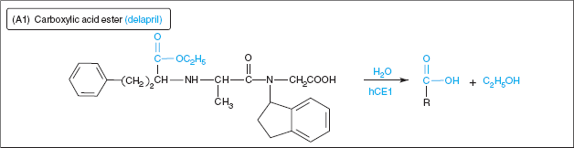
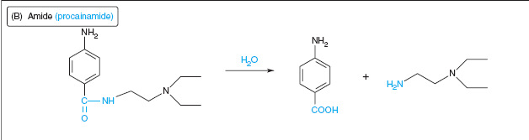
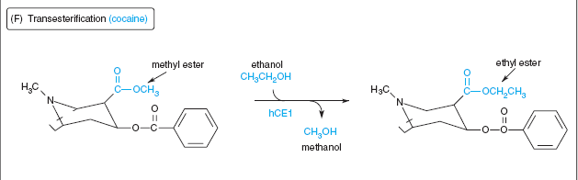
Specific Hydrolytic Reactions
Note H₂O molecule shown in reactions
hCE1 is name of hydrolytic enzyme
Here's a trans-esterification (ROH not HOH)

Slide 62
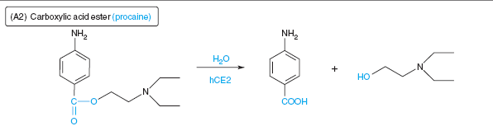
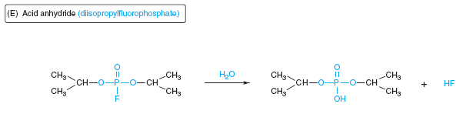
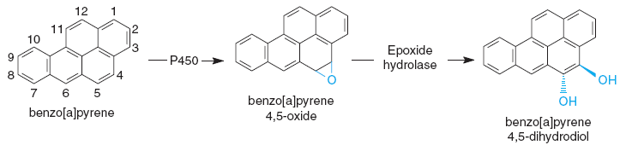
Specific Hydrolytic Reactions
procaine is local anesthetic
The organophosphate DIFP is a powerful anti-cholinesterase that was studied as a nerve warfare agent
The epoxide hydrolase follows the epoxidation by a CYP enzymes

Slide 63
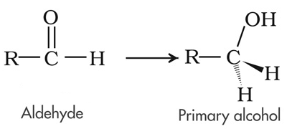
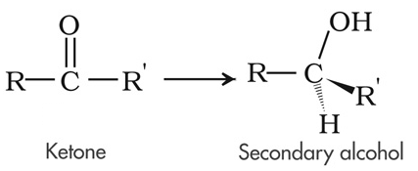
Reductions
When a molecule has electrons transferred to it (often being protonated or acquiring hydrogen atoms too), this is a reduction
These reactions are generally about reducing carbonyl groups in aldehydes & ketones
Reduction transformations can occur in three ways
Enzymatically by host NAD(P)H-dependent oxidoreductases (found in many cells, but chiefly done by liver microsomes)
Nonenzymatically perhaps by direct interaction of an reductant (NAD(P)H, FAD, FMN, glutathione) with toxicant
Intestinal bacteria which have many such enzymes

Slide 64
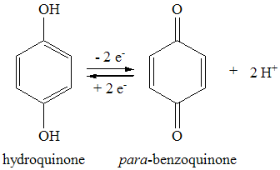
Reduction Enzymes
Many host reductases have been identified, and fall into 4 superfamilies
A table for these reductases is on the next slide
These 4 classes of reductases are
Aldo-keto reductases (AKR)
specific for carbonyl groups (C=O) on aldehydes and ketones
Short-chain dehydrogenase/reductases (SDR)
Medium-chain dehydrogenase/reductases (MDR)
Quinone reductases (NQO)

Slide 65
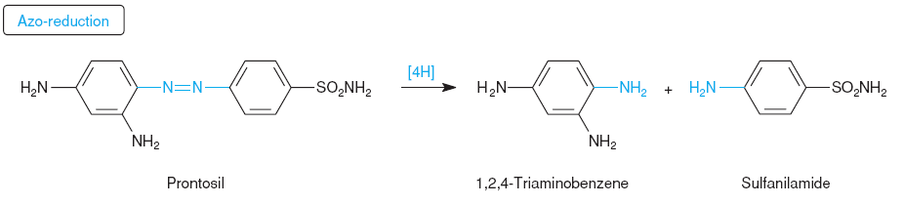
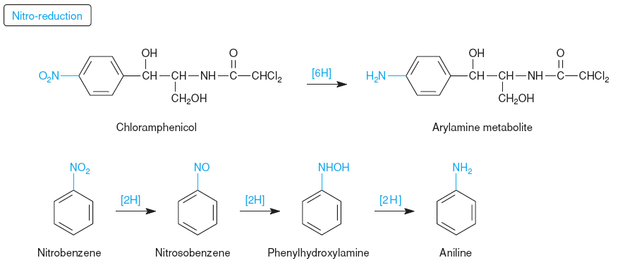
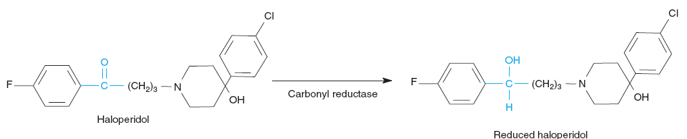
Specific Reduction Reactions
The azo group is R-N=N-R
The double bond was hydrogenated twice to split into amines
Conditions used in the laboratory to reduce aryl (aromatic ring) nitro (–NO₂) groups use toxic chemicals and catalysts
Haloperidol is an anti-psychotic used to treat schizophrenia, choreas, severe anxiety, tics in Tourette's, hiccups not responsive to other care. Used in adults and children

Slide 66
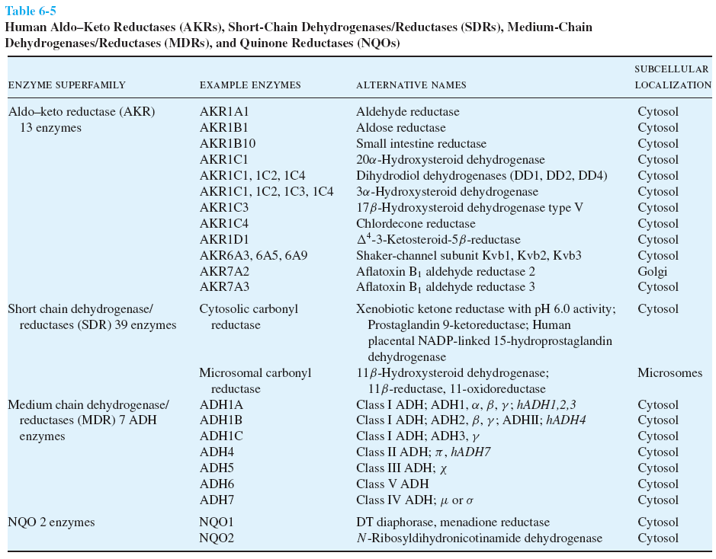

Slide 67
Oxidations
When a molecule has electrons removed from it, this is an oxidation, because much of the time, oxygen (O) atoms are taking the electrons, the O atoms becoming part of the molecule
Dehydrogenations are also oxidations because electrons are taken, although O atoms may not necessarily be bonded products nor involved in the reaction

Slide 68
Oxidation Enzymes
Alcohol, Aldehyde Dehydrogenases
NAD-based enzymes producing aldehydes and carboxylates
Mo²⁺-based Hydroxylases
Aldehyde Oxidase
An Mo²⁺-centered enzyme also
Flavin Mono-oxygenases
creates a reactive hydroperoxide that puts an O atom on the substrate
Cytochrome P450 Enzymes
oxidize a wide variety of substrates

Slide 69
Cytochrome P450 (CYP) Enzymes
These enzymes (at least 57 types) are present in all tissues, but the primary location for detoxifying done in microsomes of liver cells
The catalytic center is a iron-centered heme
In Phase I biotransformations, CYP enzymes perform oxidations
CYP enzymes are mono-oxygenases
Substrate (RH) + O₂ + NADPH + H⁺ → Product (ROH) + H₂O + NADP⁺
The enzymes binds the substrate & O₂ molecule, and gets electrons from another enzyme handling NADPH reductant

Slide 70
Specific CYP Enzymes
Families of CYP enzymes (isoforms) show differences in the variety of substrates bound
CYP3A4/CYP3A5, CYP2D6, CYP2C8/CYP2C9 and CYP1A2 have been identified as carrying out most modifications compared to other CYP isoforms
Intestinal mucosal cell CYP3A4 will metabolize drugs such as chlorpromazine & clonazepam

Slide 71
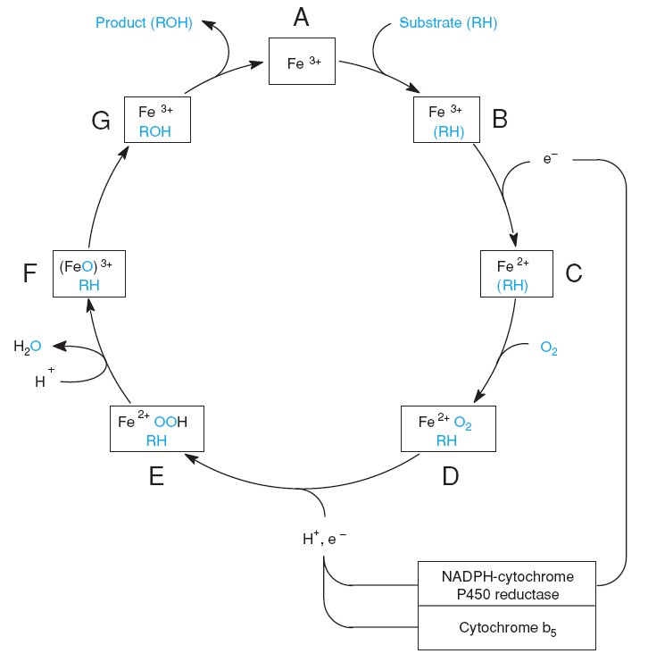
CYP Mechanism
The details on this slide are not required learning. It is merely informational for anyone fascinated by biochemistry.
The cycle starts with substrate binding to heme
Fe³⁺ is reduced to Fe²⁺ in a 1-electron reaction
O₂ then binds to the enzyme
O₂ is then "activated" in a 1-electron reduction
A single O atom is then dissociated with an oxidation of Fe²⁺, and protonation of complex involves H₂O leaving
The remaining O atom is highly energetic and reacts with the substrate, which then leaves

Slide 72
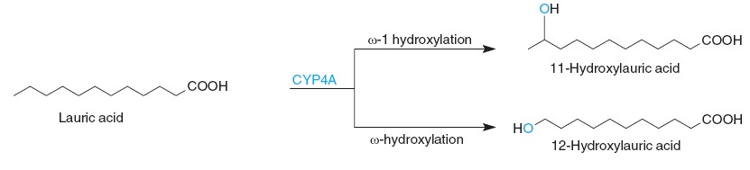
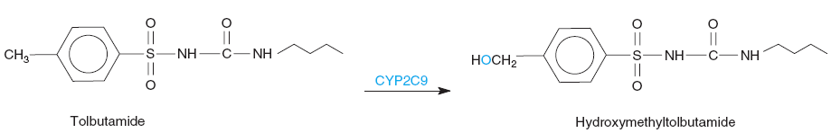
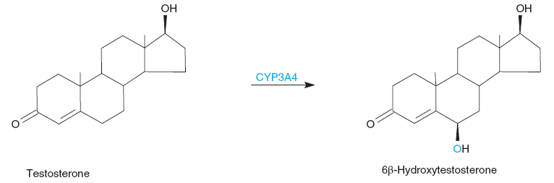
Specific CYP Reactions
Mono-oxygenation (hydroxylation) of the tail-end of long-chain alkyl groups is important
Tolbutamide is used to treat type 2 diabetes
Used in the catabolism of natural metabolites, steroids
There are far too many chemical reaction types catalyzed by CYP enzymes to show in this course: oxygenation of N and S atoms; dealkylation of O, N, S, Si; deamination, desulfuration by oxidation; epoxidation

Slide 73
Conjugation (Phase II Reactions)
Conjugation is the biochemical reaction of adding a functional group (often a large molecule) to the molecule that is either the toxicant or its product(s) that underwent Phase I reactions
Molecules that are conjugated to toxicants will give the xenobiotic more polar (multiple –OH groups) or electrically charged (particularly anionic or negatively charged) groups
Purposes
Primarily to increase the water solubility for excretion
Ipso facto, reduce the lipophilic character that allows xenobiotics to traverse membranes into other compartments
Put a "tag" on a xenobiotic that marks it for excretion
Potentially reduce its toxic nature (even further)

Slide 74
Conjugation Reactions
Glucuronidation
attaches a large anionic sugar acid (glucuronic acid) using UDPGlcA, to O atoms on ROH/RCOOH, N atoms on amines, S atoms on thiols
Sulfation
attaches anionic –SO₃– to –OH using PAPS
Acetylation
this amine modification appears to make it execretable despite loss of ionic charge

Slide 75
Conjugation Reactions
Methylation
Glutathione conjugation
Amino acid conjugation

Slide 76
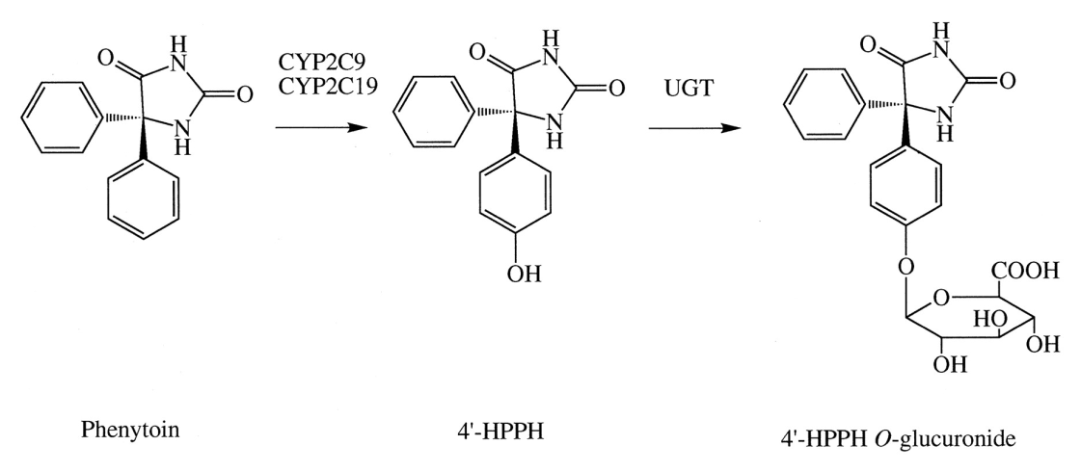
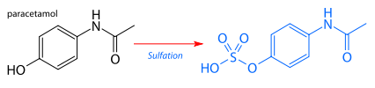
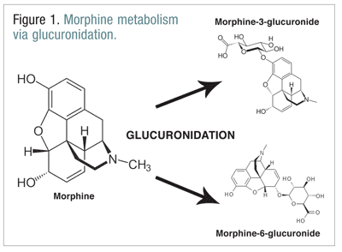
Specific Conjugation Reactions
The anticonvulsant phenytoin is hydroxylated on the ring by the P450 enzyme and then conjugated with glucuronic acid
Sulfation of acetominophen
The opiate morphine glucuronidated in several locations

Slide 77
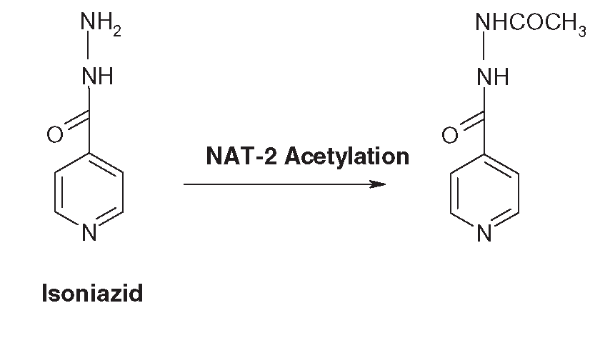
Specific Conjugation Reactions
Acetylation of the anti-tuberculosis drug isoniazid
Sulfation of acetominophen
The opiate morphine glucuronidated in several locations

Slide 78
In the very useful table on biotransformation reactions on the next slide, 3 columns are shown
The 1st column shows the chemical functional group on the toxicant to be modified or transformed
The 2nd column shows the enzyme (class) that performs the reaction/modification/transformation
The 3rd column shows the type of reaction, indicating the product to be obtained
Note that the table has two columns of the 3-column

Slide 79
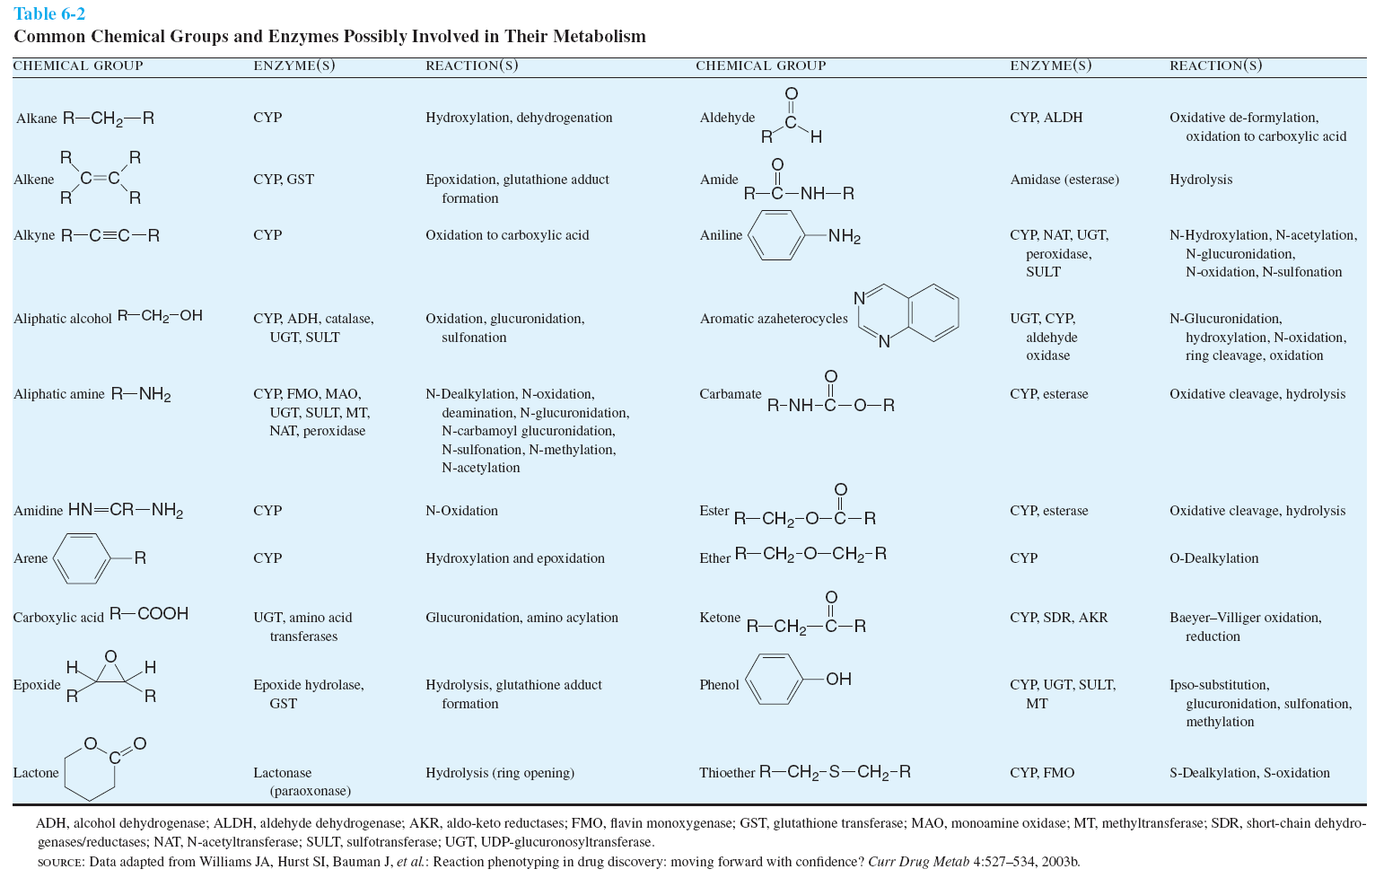

Slide 80
Phases?
There is criticism of the use of the Phase I and Phase II to describe biotransformations, as it implies a temporal sequence of reactions
There are cases where conjugation ("Phase II") reactions precede oxidation ("Phase I") for example
Aside from the debates, do not think of Phase I or Phase II as the temporal relationships, but rather as categorization of biotransformation processes

Slide 81
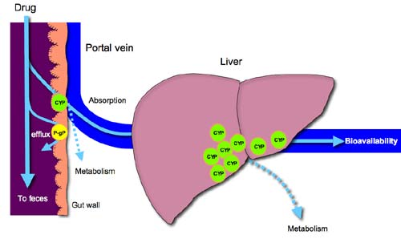
This visually summarizes previous slides, showing how a drug or toxicant can get absorbed or not, and how it will be potentially metabolized in the liver before getting a chance to be distributed in the body
CYP = cytochrome P₄₅₀ enzymes
P-gp =
P-glycoprotein
representing itself and other ATP-binding cassette (ABC) efflux transporting membrane proteins involved in multi-drug resistance
http://www.doctorfungus.org/thedrugs/images/antifung_1.jpg

Slide 82
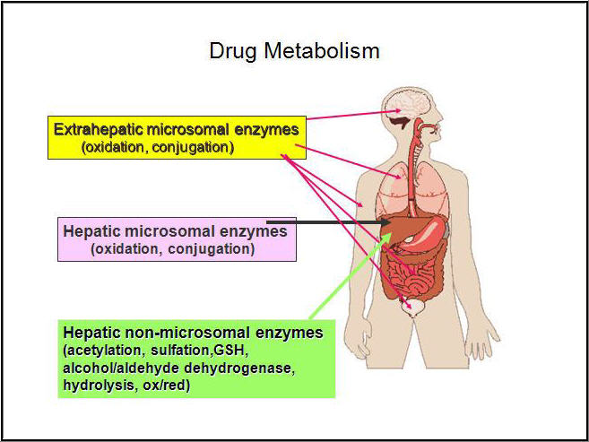
This is to summarize what toxicant/drug metabolism (biotransformation) is about, and generally where it happens in the body
http://intranet.tdmu.edu.ua/data/kafedra/internal/magistr/classes_stud/English/First%20year/Clinical%20Pharmacology/01_Clinical%20pharmacokynetic_pharmacodynamic.files/image017.jpg

Slide 83
Excretion
The process of eliminating the drug or its (de-toxified) products
Routes of elimination
Urine (kidney)
Feces (GI tract and biliary elimination)
Exhalation (lungs)
Sweat (skin)
Saliva (oral)
Breast Milk
Major routes are through urine and feces, so we concentrate on these

Slide 84
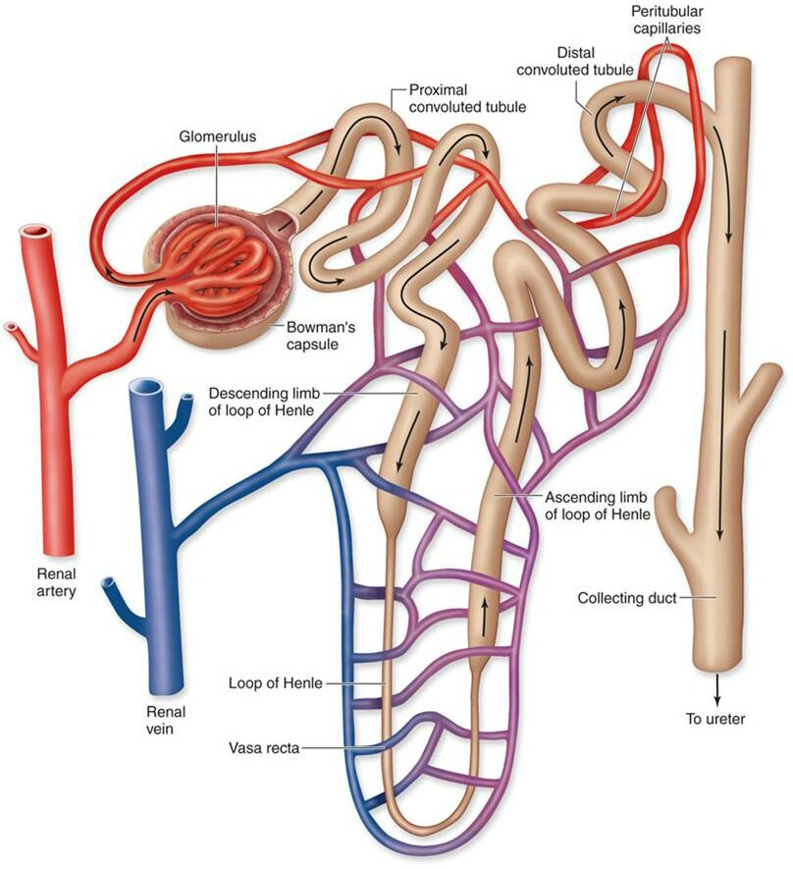
Kidney
More xenobiotics excreted by kidney than any other route
The nephron is functional unit of excretion
Glomerulus
Proximal convoluted tubules
Distal convoluted tubules
Collecting ducts
Water-soluble compounds of low MW (< 350 Da)

Slide 85
Urinary Excretion
Glomerular filtration
water + small molecules pass through net from plasma into proximal convoluted tubules (PCT)
compounds of < 60 kDa pass through large pores
albumin-bound xenobiotics retained in blood
polar and ionized toxicants filtered here may be excreted
Tubular Reabsorption
diffuse from tubule back into peritubular capillaries
Active secretion into tubules
Most drugs excreted by this process

Slide 86
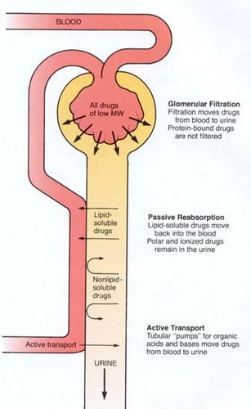
Tubular Reabsorption/Secretion
Lipophilic drugs will be re-absorbed in the proximal convoluted tubule (PCT), while ionized toxicants will pass out to the urine
Organic anions and cations can be actively secreted into the PCT from the adjoining blood vessels
https://o.quizlet.com/i/ZfKbIDUW0AbVVEH4_97uOg.jpg

Slide 87
Biliary-Fecal Excretion
More xenobiotics excreted by kidney than any other route

Slide 88
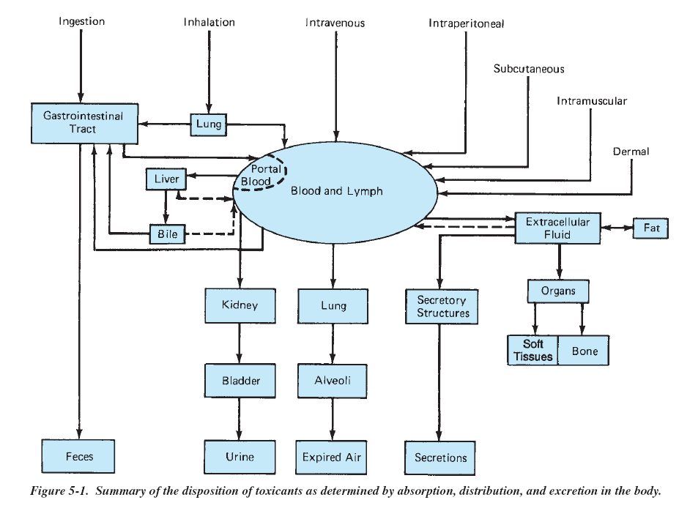

Slide 89
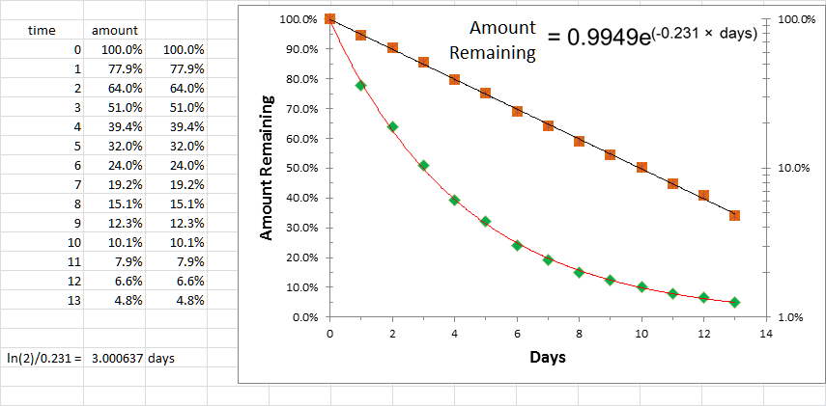
Half-Life
The time period between an initial amount of something (a substance) to the point where half of the initial amount is present

Slide 90

Drug/Toxicant Half-Life
The half-life of a drug depends on its volume of distribution and clearance
For patients taking therapeutic drugs, the half-life is used to determine the dosing interval in order to maintain a steady-state level (concentration) to maintain the therapy/effect
For drugs with a narrow therapeutic index (TI), the time required to reach a steady-state level could be much longer since patient body fluids (serum) must be assayed to monitor dose with serum levels
This value can be computed as
$$t_{1/2}=\frac{\ln{2}}{k_{\text{el}}}$$
where k_{el} is the rate of elimination of the drug from the blood

Slide 91
Group Project
Find partner
Decide an area of interest
Develop clear, concise research question in the area of interest
Clarify the specific aims in answering the question
Do literature search to establish knowledgebase (heavy note taking)
Before start of Week 3, submit following
research question (item 3)
proper bibliography along with question before start of Week 3

Slide 92
Subdisciplines of Toxicology
Environmental
Poisons
Exposure

Slide 93
Government & Toxicology
United States (Federal) Government
Environmental Protection Agency (EPA)
Clean Air
Clean Water
Food & Drug Administration (FDA)
Safety
Efficacy

Slide 94
Government & Toxicology
California (State) Government
Environmental Protection Agency (CalEPA)
Air Resources Board (ARB)

Slide 95
Applications of Pharmacology & Toxicology
Week 2

Slide 96
Terms / Definitions / Descriptions
Ultimate toxicant
Toxication
A biotransformation of a substance that results in a relatively more harmful product. Also called metabolic activation
Detoxication
A biotransformation eliminating an ultimate toxicant or preventing its formation

Slide 97
Material Safety Data Sheet (MSDS)
Important for all factory and laboratory workers handling substances, whether GRAS or with known toxic properties
GRAS = generally regarded as safe
Referred to by hazardous material/emergency personnel
Includes information on
physical and chemical properties
handling, storage
toxicity levels (TD50, LD50, etc)
acute & chronic exposure symptoms + first aid
disposal / detoxification
firefighting
supplier of information

Slide 98
MSDS Usefulness
OSHA requires MSDS be available to all personnel in workplace as well as to first responders and state and local emergency planning officials
Companies prepare MSDS however and there is wide variability in information given within standardized sections of the MSDS
Usually updated every 3-5 years, although immediate revision and updating is required with notification in some jurisdictions
MSDS for any substance is usually available on the Internet: be sure to download from several sites to compare & contrast information

Slide 99
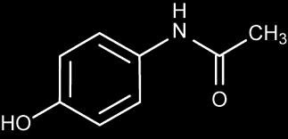
Acetaminophen
Name used in US, Canada, Japan
Tylenol® is brand by McNeil Laboratories
Paracetamol is name used around world
Indications (FDA website)
Acetaminophen is an active ingredient in hundreds of over-the-counter (OTC) and prescription medicines. It relieves pain and fever. And, it is also combined with other active ingredients in medicines that treat allergy, cough, colds, flu, and sleeplessness. In prescription medicines, acetaminophen is found with other active ingredients to treat moderate to severe pain. Acetaminophen can cause serious liver damage if more than directed is used. The FDA has taken action to improve the safety of consumers when using acetaminophen.
Last sentence appears to disclose that the public underestimates the toxicity

Slide 100
Acetaminophen - Epidemiology
Acute liver failure studied in 49 adults and 16 children (Atlanta area)
46% of adult ALF cases were related to acetaminophen (another 16% were "drug-related")
Of the 46% acetominophen cases, 27% were accidental overdose, 27% were accidental OD with alcohol, and balance intentional
1 in 4 of child ALF cases were attributed to acetominophen
Source: W. Bower, "Acute Liver Failure and Acetominophen" (FDA website)
Year 2000: was 5% of reported overdoses of all drugs, and accounted for 23% of fatalities attributed to overdoses

Slide 101
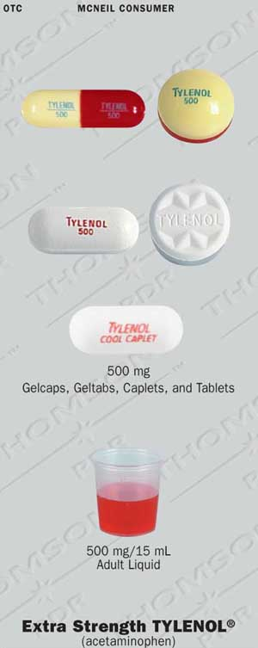
Acetaminophen – Dosage Forms
Adults & Children over 12 years
"Regular Strength" – 325 mg
"Extra Strength" – 500 mg
Pediatric
160 mg / 5 ml syrup
"bubble gum" "grape splash" flavored
80 mg / 0.8 ml infant formulation
tablets
chew-tabs
gelcaps
geltab
capsules
suppositories

Slide 102
Acetaminophen – Poisoning
Recommended Dosing
12 years and older
650-1000 mg recommended q 4-6 h prn
Not more than 4000 mg within 24 h
Under 12 years of age
10-15 mg/kg q 4-6 h
Not more than 5 doses (50-75 mg/kg) in 24 h
Acute (within 4 h period) Toxicity Dosing
by oral route
7.5 g (7500 mg) adults
150 mg/kg pediatric
Chronic (> 4 h period) Toxicity Dosing
> 7.5 g/day adults & > 150 mg/kg/d children
no risk factors: alcoholism, drugs potentiating CYP450 (Rifampin, anticonvulsants)

Slide 103
Acetaminophen – Pharmacokinetics
systemic bioavailability = 70-90% after GI tract absorption
peak serum levels within 30-120 minutes
sustained release and combination formulations have different kinetics
Vd = 0.9 L/kg
Biotansformations
4% of drug excreted in urine unchanged
Phase II: conjugation with sulfate (52% of drug) and glucuronide (42% of drug)
Phase I: 2% of drug metabolized by CYP2E1: oxidized to a quinone product, N-acetyl-p-benzoquinoneimine (NAPQI)
This quinone is quite toxic (acetaminophen is "metabolically activated"), but it reacts (conjugates) quickly with reactive thiol (–SH) groups, normally with glutathione but also with proteins having a cysteine thiol

Slide 104
Acetaminophen – Drug Interactions

Slide 105
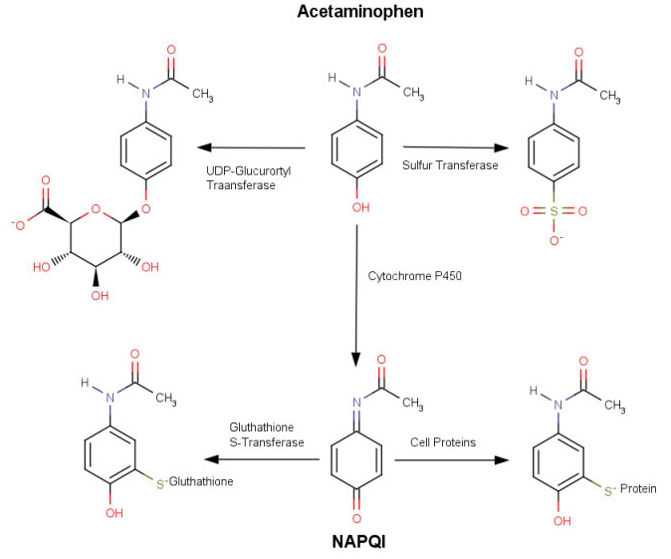

Slide 106
Ethanol (Ethyl Alcohol)

Slide 107
Aromatic Hydrocarbons
Simplest is benzene, a known chemical carcinogen
Polycyclic aromatic hydrocarbons (PAHs) are found everywhere

Slide 108
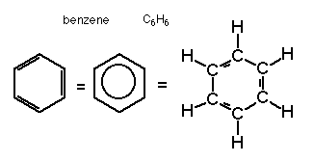
Benzene
simplest aromatic hydrocarbon
clear, volatile, flammable liquid
colorless to light yellow
(sweet) "aromatic odor"
raw material in high volume
solvent for chemical & pharmaceutical industries
gasoline additive
common environmental pollutant
ubiquitous in air
detected in ground water

Slide 109
Benzene Toxicity
Routes of exposure
inhalation
dermal absorption
Acute exposure
Chronic exposure

Slide 110
Induced Deficiencies

Slide 111
Genomic Impact

Slide 112
Metabolic Impact

Slide 113
Chiropractic Medicine
American Chiropractic Association House of Delegates recently passed a resolution calling for "prescriptive authority" and for establishment of College of Pharmacology & Toxicology, but do not endorse the use of pharmaceuticals in the approach to health care

Slide 114
Philosophy of Chiropractic Med
70% of Americans now take at least one prescription drug
Many healing approaches
What should be the first approach ("resort")?
Last resort?
What are your obligations in discussing the resolution to the patient's chief complaint?

Slide 115
Holistic Management

Slide 116
Sources
A House Divided? ACA House of Delegates passes two controversial resolutions.
ACA clarifies Scope of Practice policy and new College of Pharmacology and Toxicology

Slide 117
Group Activity
Pharmacokinetics
Mechanisms of Action

Slide 118
More Applications of Pharmacology & Toxicology
Week 3

Slide 119
Environmental Toxins

Slide 120
Metal Toxicities

Slide 121
Chelation Chemistry

Slide 122
Chelation Therapy

Slide 123
Group Work
Research access to assessment protocols, laboratories and specific analyses for management of toxic exposure
Review these with instructor
Take-home midterm to be posted to MOODLE

Slide 124
More Applications of Pharmacology & Toxicology
Week 4

Slide 125
Personal Care Products

Slide 126
Phthalates

Slide 127
Xenobiotics

Slide 128
Drug Interactions

Slide 129
Herbs

Slide 130
Vitamins & Minerals

Slide 131
Endocrine Disruptors

Slide 132
Group Work
Continue research on clinical management of toxic exposure

